Slide 1
GitHub
Copyright © 2018 Cybage Software Pvt. Ltd. All Rights Reserved. Cybage Confidential.
www.cybage.com

Slide 2
Agenda
What is a git and GitHub
Advantages
Github Structure
Features
Github Concepts
User management
Github Workflow
Git commands for collaboration
Branching
Pull requests
Webhooks
Forks

Slide 3
What is Git & Github ?
Git is an example of version control.
Version control is a system that records changes to a file or set of files and helps us recall specific versions later if needed.
Github is a repository hosting service for Git
• While Git is a command line tool, GitHub provides a web-based graphical interface that works on top of GIT.
It can also be treated as a social platform to share knowledge and work.
It also provides access control and several collaboration features.
Integrates with other tools like Jenkins, Jira, etc.

Slide 4
Advantages
Collaboration between developers
Provides many features like pull request, hooks, access/permissions management, etc.
Nice UI for browsing code
Integrates with other tools like Jenkins, Jira, etc.

Slide 5
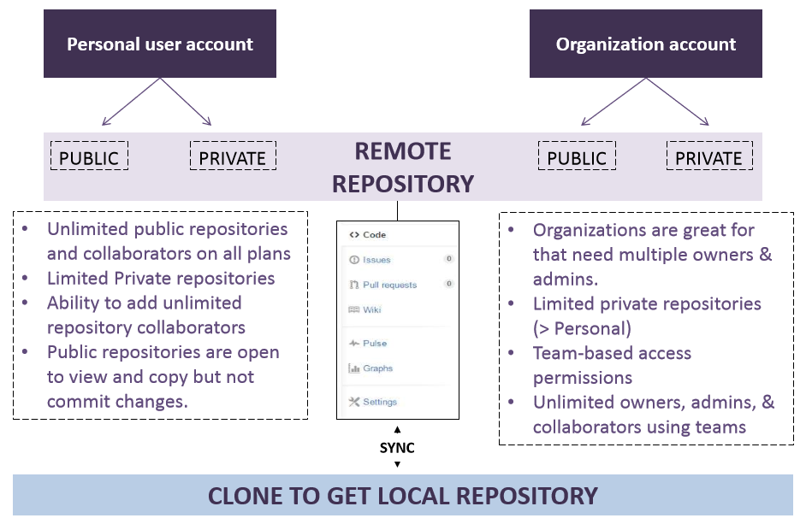
Github Structure

Slide 6
Features of Git repository management tools
Create a repository and get your code into it
User Authentication
Forks
Using branches
Pull Request
Repository hooks

Slide 7
Github Concepts
Creating a repo
Creating a repository for multiple people to work together
Master in a repository
This is the final version that is considered ready to use by anybody in the team or outside if repository is public.
Creating a Branch
• Create a branch in your project, for an environment where you can try out new ideas.
• Changes you make on a branch don't affect the master unless pull request is accepted.
• Changes committed to branch reflects for you to keep track of different versions

Slide 8
Github Concepts
Adding Commits
• Keeps track of your progress as you work on a branch or master.
• Creates a transparent history that others can follow to understand what you've done and why
Issues
• Highlight bugs or issues with codes that need rectification. Issues remain open unless resolved.
• Can be filtered, Can be labeled as bug/question/help wanted
• @mention can be used to notify someone
Watch and Star
Watch notifies us of all conversations over and above your @mentions, commits, comments on discussion. Star will favorite it but not show on your dashboards like watch

Slide 9
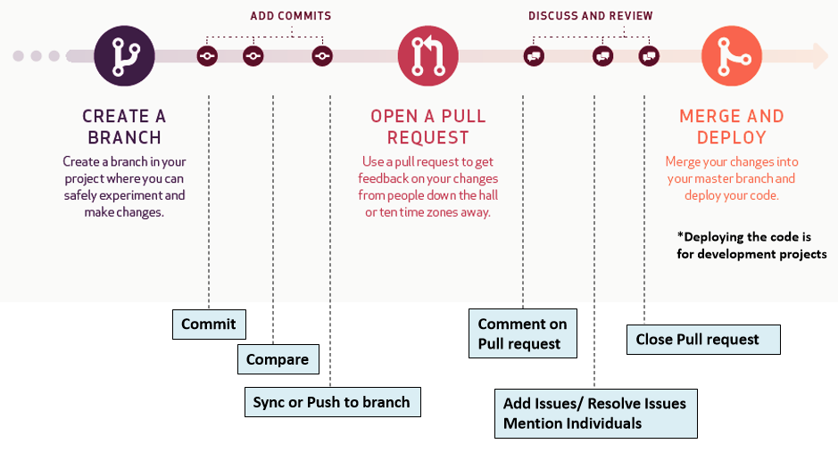
Github Workflow

Slide 10
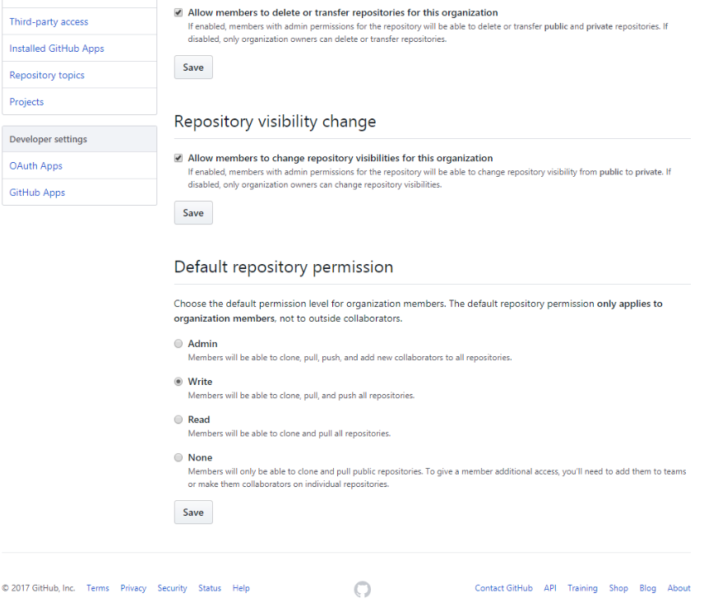
User Management in Github

Slide 11
Git commands for collaboration
If you have a repository locally, version control it (if it isn’t version controlled) using “git init” command.
To copy entire repository of Bitbucket locally, use “git clone” command.
To add file contents updated , use “git add”
To record changes to the local repository , use “git commit”
To pull new changes from Bitbucket to local repository, use “git fetch” or “git pull” command.
Push this repository to Bitbucket using “git push” command.

Slide 12
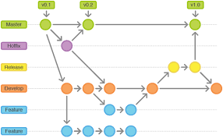
Branching
$ git branch
* Master
$ git branch <feature_branch>
$ git checkout <feature_branch>
$ git add .
$ git commit -m "adding a change from the feature branch“
$ git checkout master
$ git merge <feature_branch>
$ git push origin <feature_branch>

Slide 13
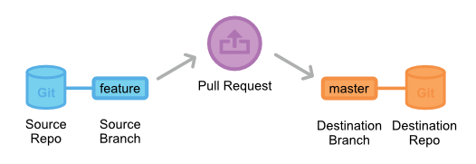
Pull Request
Pull request is a request to team lead or approver of code to review the code of source branch and merge the code from source branch to target branch.
After pull request is created, code is reviewed.
If code is satisfactory, pull request is merged and closed.
Else, changes can be suggested and/or it can be closed without merging i.e rejected.

Slide 14
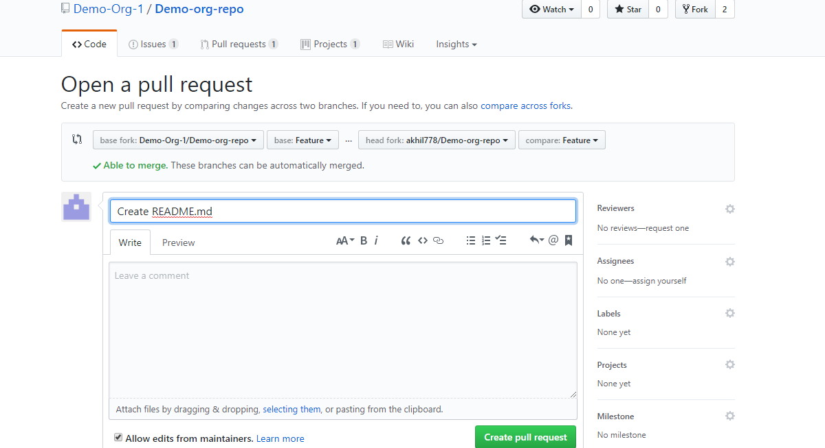
Creating a Pull Request

Slide 15
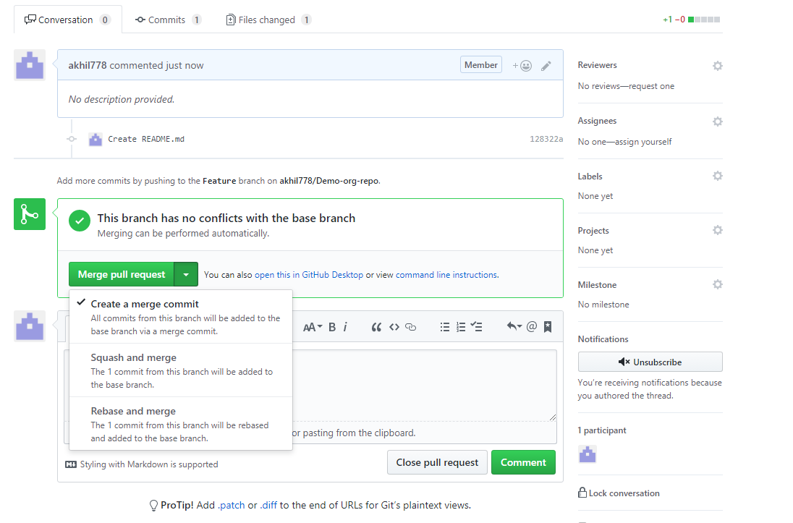
Discussing a Pull Request

Slide 16
Webhooks
Webhooks provide a way to configure Bitbucket to make requests to your server (or another external service) whenever certain events occur in Bitbucket
A webhook consists of:
A subject – the resource that generates the events
Eg: the repository where you create the webhook
One or more events – the default event is a repository push, but you can select multiple events that can trigger the webhook.
A URL – the endpoint where you want Bitbucket to send the event payloads when a matching event happens.

Slide 17
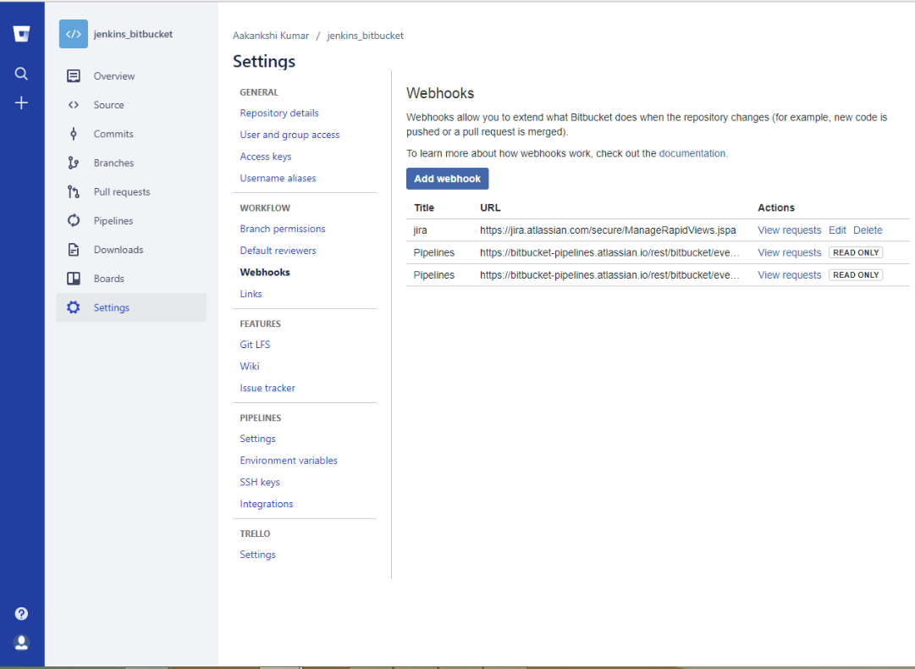
Webhooks

Slide 18
Forks
What is fork?
Creating a fork of someone's repository means to create a copy of that repository in your own GitHub account.
Why forks?
Forking is necessary when you want to share your changes to the repository to which you don't have write access.
Then pull request can be created from source repository to target repository.

Slide 19
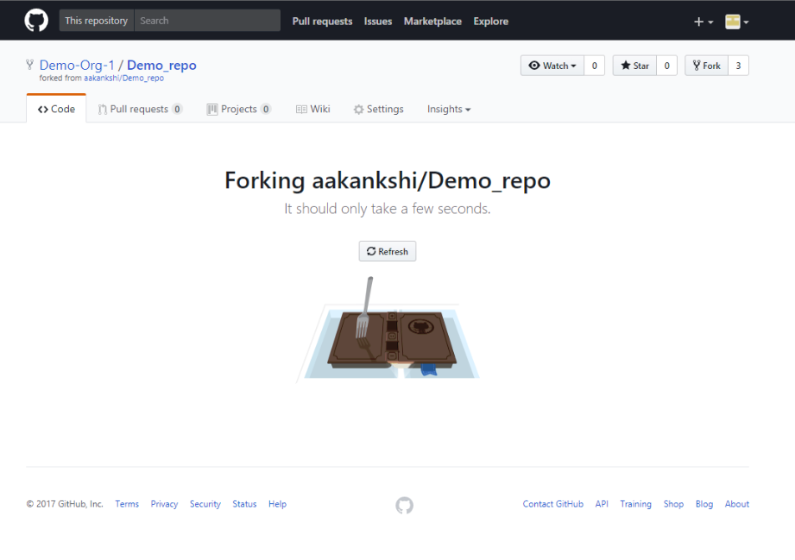
Creating a Fork

Slide 20

Questions?

Slide 21
Thank You!
Copyright © 2018 Cybage Software Pvt. Ltd. All Rights Reserved. Cybage Confidential.
www.cybage.com

